Slide 1
Error Handling and Tracing
Presented by
Sun Teik Heng

Slide 2
Introduction
Learn the following:-
use structured exception handling to defend your ASP.NET applications against common errors.
page tracing
Notes:
No software can run free from error, and ASP.NET applications are no exception.
use structured exception handling to defend your ASP.NET applications against common errors
page tracing allows you to see diagnostic information about ASP.NET pages and may help you solve mysterious issues

Slide 3
Common Errors
attempts to divide by zero
attempts to connect to a limited resource such as a file or a database (which can fail if the file doesn’t exist, the database connection times out, or the code has insufficient security credentials)
null reference exception, which usually occurs when a program attempts to use an uninitialized object.

Slide 4
Sample coding error
' Define a variable named conOne and create the object.
Private conOne As New SqlConnection()
' Define a variable named conTwo, but don't create it.
Private conTwo As SqlConnection
Protected Sub cmdDoSomething_Click(sender As Object, _
e As EventArgs) Handles cmdCompute.Click
' This works, because the object has been created
' with the New keyword.
conOne.ConnectionString = "..."
...
' The following statement will fail and generate a
' null reference exception.
' You cannot modify a property (or use a method) of an
' object that doesn't exist!
conTwo.ConnectionString = "..."
...
End Sub

Slide 5
A sample error page

Slide 6
Handling Error in Code
An error page can shatter the professional appearance of any application
Error should be caught in the code and identified.
Report a more useful (and user-friendly) page of information that might include a link to a support e-mail or a phone number where the customer can receive additional assistance if the error is a critical one that the application cannot solve on its own.

Slide 7
Structured Exception Handling
Essentially, when an error occurs in your application, the .NET Framework creates an exception object that represents the problem. You can catch this object by using an exception handler. If you fail to use an exception handler, your code will be aborted, and the user will see an error page. If you catch the exception, you can notify the user, attempt to resolve the problem, or simply ignore the issue and allow your web page code to keep running.

Slide 8
Key features of structured exception handling
Exceptions are object-based
Exceptions are caught based on their type
Exception handlers use a modern block structure
Exception handlers are multi-layered
Exceptions are a generic part of the .NET Framework

Slide 9
The Exception Class
Every exception class derives from the base class System.Exception.
Some of the predefined exception classes:-
NullReferenceException, IOException, SqlException

Slide 10
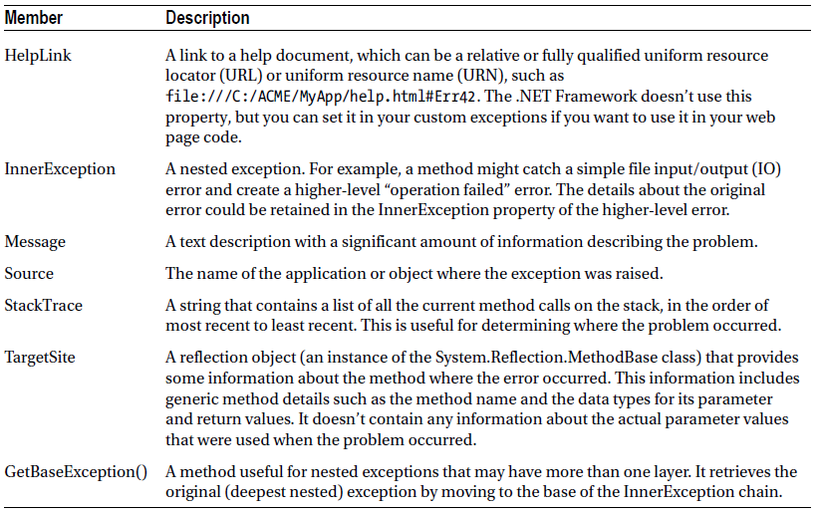
Exception Properties

Slide 11
Visual Studio’s exception viewer

Slide 12
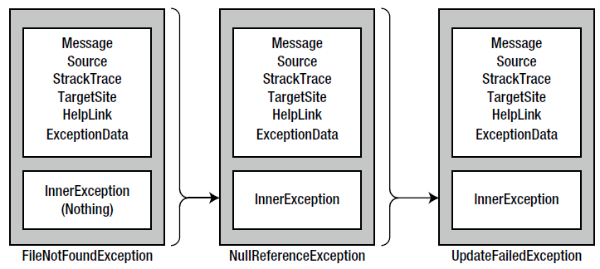
Exceptions can be chained together

Slide 13
Handling Exceptions
Check for potential error conditions before performing an operation
Example,
If Divisor <> 0 Then
' Safe to divide some number by Divisor.
End If
If System.IO.File.Exists("myfile.txt") Then
' You can now open the myfile.txt file.
' However, you should still use exception handling because a variety of
' problems can intervene (insufficient rights, hardware failure, etc.).
End If

Slide 14
Handling Exceptions
It may not be practical to perform the full range of defensive checks, because they may impose a noticeable performance drag on your application
Solution: structured exception handling
Try
' Risky code goes here (opening a file, connecting to a database, and so on).
Catch
' An error has been detected. You can deal with it here.
Finally
' Time to clean up, regardless of whether or not there was an error.
End Try

Slide 15
Catching Specific Exceptions
Add multiple Catch statements, each one identifying the type of exception (and providing a new variable to catch it in)
Try
' Database code goes here.
Catch err As System.Data.SqlClient.SqlException
' Catches common database problems like connection errors.
Catch err As System.NullReferenceException
' Catches problems resulting from an uninitialized object.
End Try
Organize your Catch statements from most specific to least specific

Slide 16
Different exception handlers filter out different types of problems
Protected Sub Page_Load(sender As Object, _
e As EventArgs) Handles Me.Load
Try
Dim Average As Integer = GetAverageCost(DateTime.Now)
Catch err As DivideByZeroException
' Report error here.
End Try
End Sub
Private Function GetAverageCost(saleDate As Date) As Integer
Try
' Use Database access code here to retrieve all the sale records
' for this date, and calculate the average.
Catch err As System.Data.SqlClient.SqlException
' Handle a database-related problem.
Finally
' Close the database connection.
End Try
End Function

Slide 17
Catching and displaying exception information
Public Partial Class ErrorHandlingTest
Inherits System.Web.UI.Page
Protected Sub cmdCompute_Click(sender As Object, _
e As EventArgs) Handles cmdCompute.Click
Try
Dim A, B, Result As Decimal
A = Decimal.Parse(txtA.Text)
B = Decimal.Parse(txtB.Text)
Result = A / B
lblResult.Text = Result.ToString()
lblResult.ForeColor = System.Drawing.Color.Black
Catch err As Exception
lblResult.Text = " < b > Message:</b > " & err.Message & " < br /> < br />"
lblResult.Text & = " < b > Source:</b > " & err.Source & " < br /> < br />"
lblResult.Text & = " < b > Stack Trace:</b > " & err.StackTrace
lblResult.ForeColor = System.Drawing.Color.Red
End Try
End Sub
End Class

Slide 18
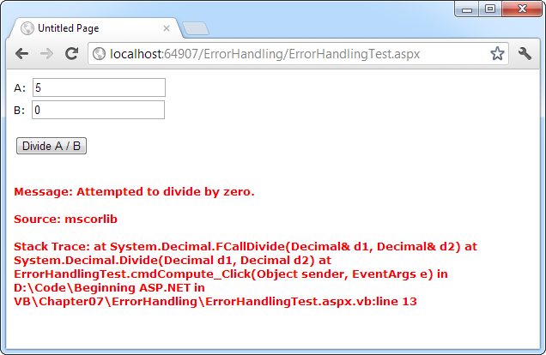
Catching and displaying exception information

Slide 19
Throwing Your Own Exceptions
Protected Sub Page_Load(sender As Object, _
e As EventArgs) Handles Me.Load
Try
DivideNumbers(5, 0)
Catch err As DivideByZeroException
' Report error here.
End Try
End Sub
Private Function DivideNumbers(number As Decimal, _
divisor As Decimal) As Decimal
If divisor = 0 Then
Dim err As New DivideByZeroException( _
"You supplied 0 for the divisor parameter. You must be stopped.")
Throw err
Else
Return number/divisor
End If
End Function

Slide 20
Standard exception, custom message

Slide 21
Custom exception classes
should always inherit from System.ApplicationException
can add properties to record additional information
Public Class CustomDivideByZeroException
Inherits ApplicationException
' Add a variable to specify the "other" number.
' Depending on the circumstance, this might help diagnose the problem.
Public DividingNumber As Decimal
End Class

Slide 22
Constructors for Custom Exception
Need to supply the custom exception with the three standard constructors
On its own, with no arguments
With a custom message
With a custom message and an exception object to use as the inner exception

Slide 23
Forwarding the parameters to the base class (the constructors in the inherited ApplicationException class)
Public Class CustomDivideByZeroException
Inherits ApplicationException
' Add a variable to specify the "other" number.
' Depending on the circumstance, this might help diagnose the problem.
Private _dividingNumber As Decimal
Public Property DividingNumber() As Decimal
Get
Return _dividingNumber
End Get
Set(value As Decimal)
_dividingNumber = value
End Set
End Property
Public Sub New()
MyBase.New()
End Sub
Public Sub New(message As String)
MyBase.New(message)
End Sub
Public Sub New(message as String, inner As Exception)
MyBase.New(message, inner)
End Sub
End Class

Slide 24
Lesson 3: Wrap-up
Summarize important points.
Allow time for questions.

Slide 25
Summary of Training
List important points from each lesson.
Provide resources for more information on subject.
List resources on this slide.
Provide handouts with additional resource material.

Slide 26
Assessment and Evaluation
Prepare a quiz or challenge to assess how much information participants learned.
Survey participants to see if they found the training beneficial.

